Slide 1

PGPDSE FT Capstone Project – Final Presentation
Retail Sales Analytics for Predictive Insights & Business Recommendations
Batch | DSE- FT-Chennai, May 2024 – G8
Team members | Deborah Nivetthini Priyadharshini Aryan Arun Santosh
Project Domain | Retail Data Analytics
Team Leader | Arun
Mentor | Avanish Kumar Singh

Slide 2
TABLE OF CONTENTS
S. NO. | TOPIC | PAGE NO
1 | BUSINESS PROBLEM STATEMENT 1.1 BUSINESS IMPACT OF SUPPLY-DEMAND MISMATCHES | 3
2 | PROPOSED SOLUTION TO THE PROBLEM EXPECTED VALUE ADDITIONS AND BENEFITS | 4
3 | EXPLORATORY DATA ANALYSIS (EDA) | 5
4 | TIME SERIES ANALYSIS | 7
5 | SALES TREND | 8
6 | TIME SERIES DECOMPOSITION, MOVING AVERAGE OF SALES | 9
7 | REMOVING MULTICOLLINEARITY | 10
8 | MODEL EVALUATION FUNCTION | 11

Slide 3
S. NO. | TOPIC | PAGE NO
9 | EVALUATION USING LINEAR MODELS | 13
10 | PERFROMANCE EVALUATION OF ADVANCED MODELS | 14
11 | FUTURE WORK | 17
12 | CONCLUSION | 18

Slide 4
BUSINESS PROBLEM STATEMENT
Retail sales analytics deliver predictive insights and actionable business recommendations to enhance sales forecasting, markdown optimization, and operational efficiency.
BUSINESS IMPACT OF RETAIL DATA ANALYTICS:
Financial Impact: Accurate sales forecasting minimizes stockouts, reducing lost sales, while optimizing inventory levels lowers holding costs and markdown losses.
Customer Experience: Data-driven insights ensure product availability, enhancing customer satisfaction, loyalty, and repeat purchases.
Operational Efficiency: Improved demand forecasting streamlines inventory management, reducing waste, storage costs, and supply chain inefficiencies.
Strategic Decision-Making: Actionable analytics enable dynamic pricing, personalized marketing, and efficient resource allocation, maximizing profitability.

Slide 5
PROPOSED SOLUTION TO THE PROBLEM
To enhance sales forecasting, we propose leveraging an Extra Trees Regressor, a robust machine learning model that captures complex patterns efficiently. By incorporating historical sales, promotions, and store-specific features, the model will deliver more precise predictions.Advanced Machine Learning Model: Implement a tuned Extra Trees Regressor for improved forecasting accuracy.Feature Engineering: Utilize historical sales, promotional impact, and store-specific attributes for enhanced prediction.Hyperparameter Optimization: Fine-tune model parameters to minimize error and maximize predictive power.
EXPECTED VALUE ADDITIONS AND BENEFITS
This solution will lead to better demand forecasting, reducing stock shortages and excess inventory. Additionally, it will enable data-driven promotional strategies and efficient resource management, ultimately boosting profitability.Higher Forecast Accuracy: Reduces uncertainty in inventory planning and stock management.Optimized Promotions: Helps in scheduling discounts and offers based on data-driven insights.Better Resource Allocation: Supports efficient staffing and logistics decisions for peak sales periods.Increased Revenue: Enhances decision-making to drive higher profitability through improved demand prediction.

Slide 6
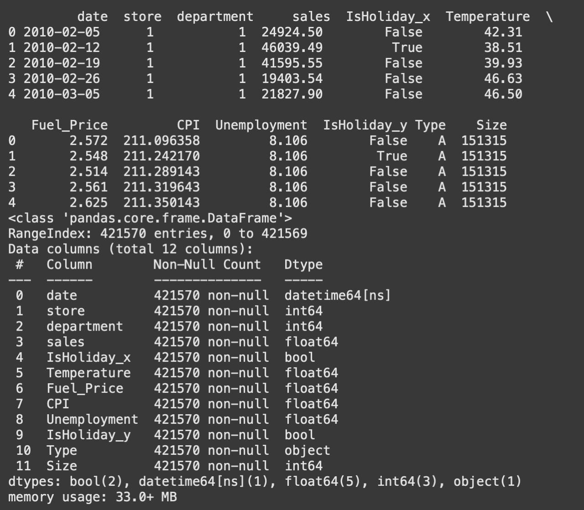
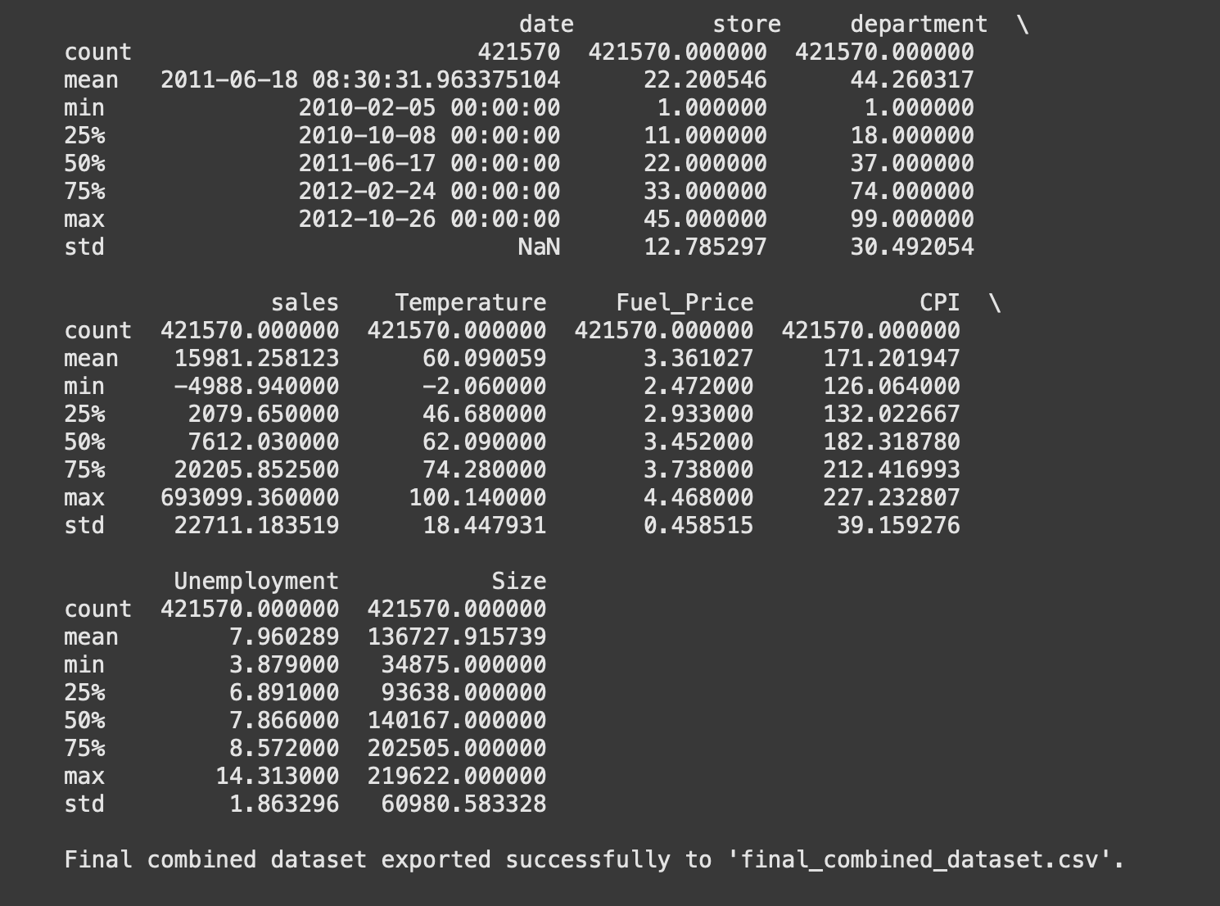
EXPLORATORY DATA ANALYSIS (EDA)
DATASET DESCRIPTION AND DOMAIN
A dataset is created after merging all three datasets.

Slide 7
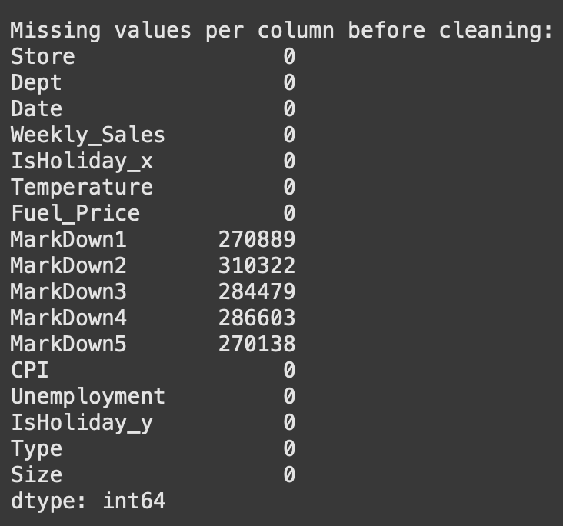
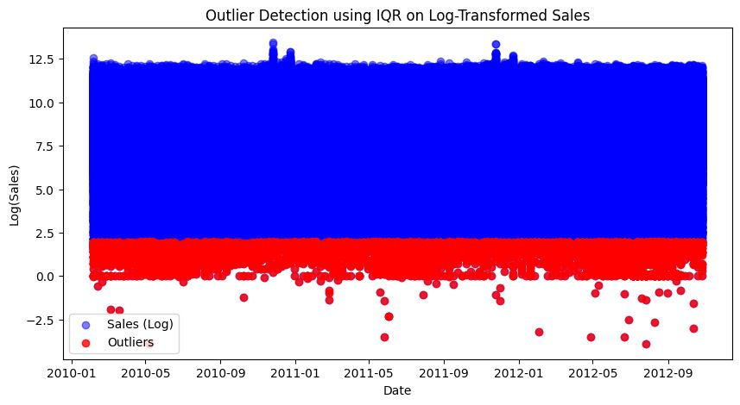
HANDLING MISSING VALUES
Defined a 25% missing value threshold for each column and dropped the columns
as necessary ie ['MarkDown1', 'MarkDown2', 'MarkDown3', 'MarkDown4', 'MarkDown5']
Used forward fill for missing categorical data.
For numerical data the missing data is replaced with median.
OUTLIER DETECTION
Outliers were detected using IQR method
Sales were log transformed to handle extreme values
⁠A 2.5 threshold was used both upper and lower bounds

Slide 8
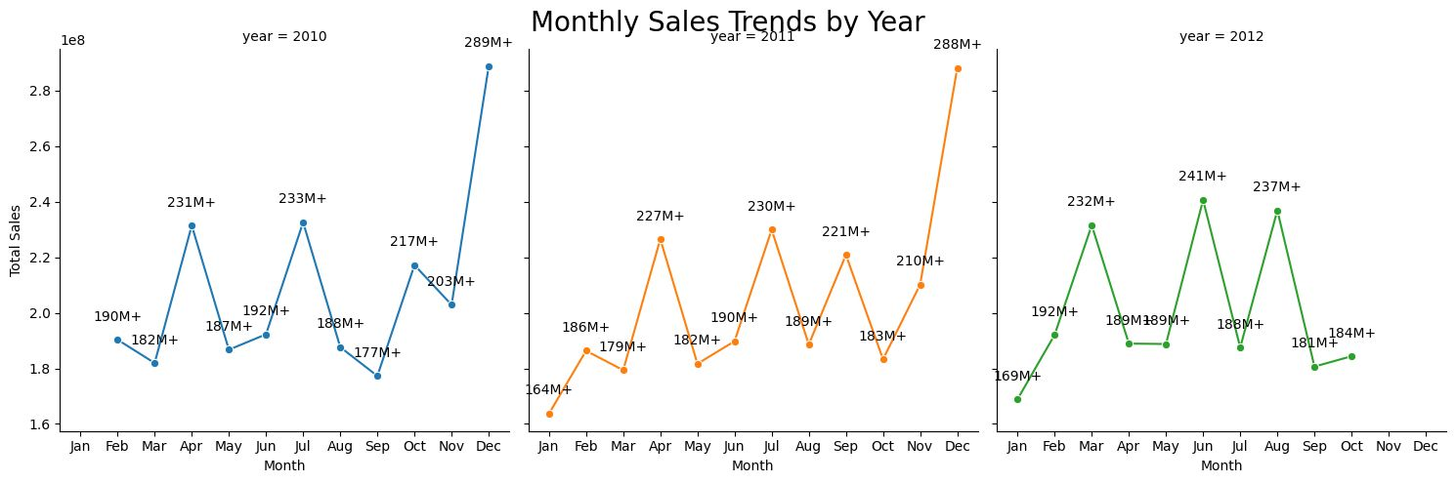
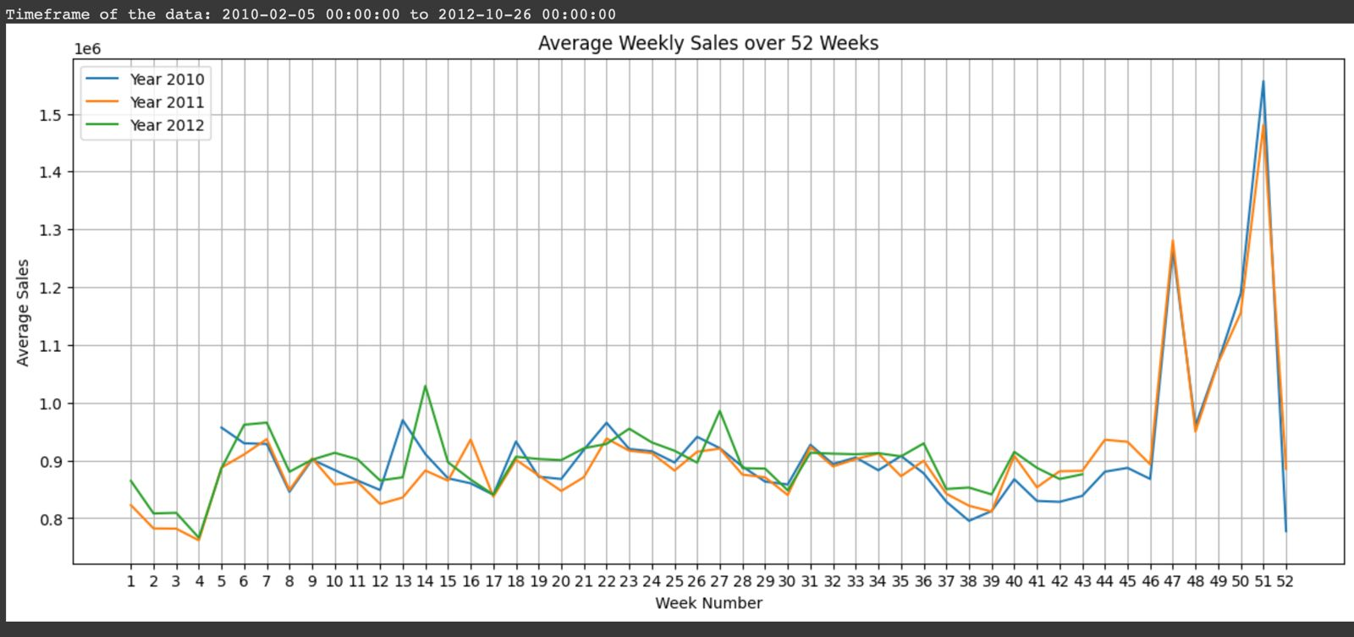
Time Series Analysis

Slide 9
SALES TRENDS
Sales trends exhibit a recurring seasonal pattern, with increases or decreases occurring during the same set of weeks each year.
Total sales generally scale with store size, with larger stores achieving higher sales. While a few exceptions exist, this pattern holds across most stores.

Slide 10
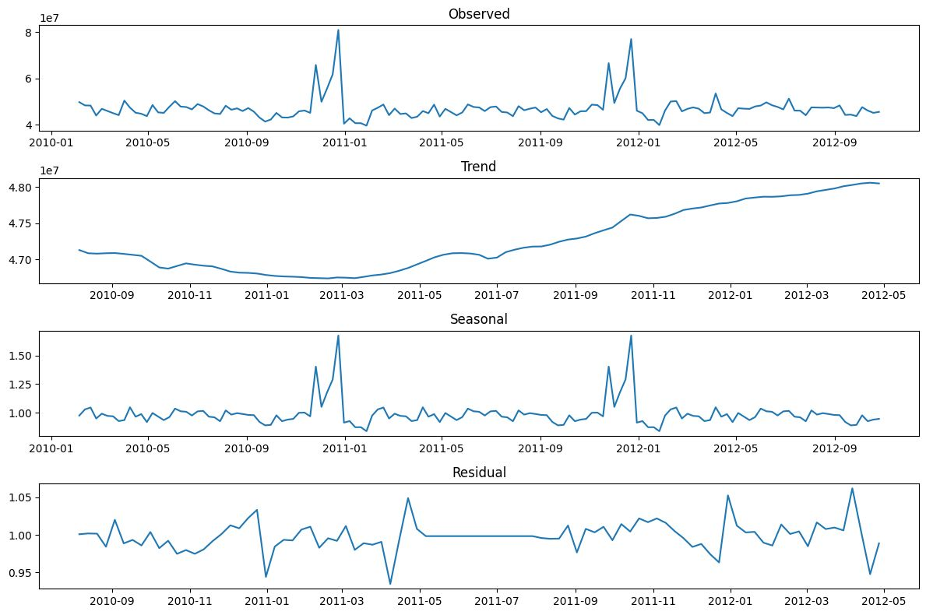
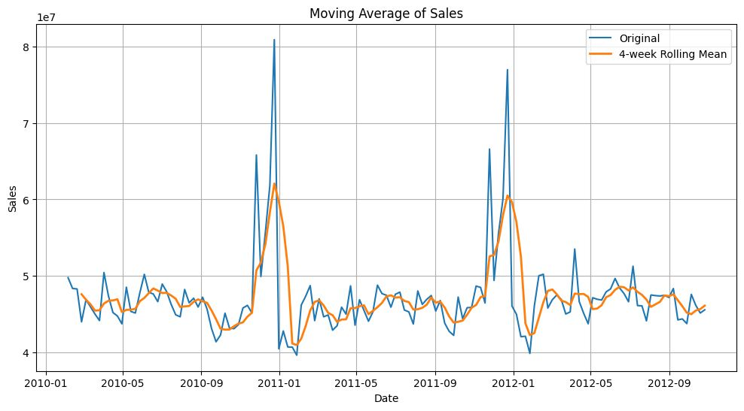
TIME SERIES DECOMPOSITION
Insights:
•The Observed graph shows the overall sales pattern over time, with noticeable spikes during specific periods.
•The Trend component reveals a steady upward trajectory, indicating overall growth in sales.
•The Seasonal component highlights recurring spikes, suggesting a yearly seasonal sales pattern.
•The Residual component captures random fluctuations that are not explained by the trend or seasonality.
MOVING AVERAGE OF SALES
Insights:
•The moving average (4-week rolling mean) smooths short-term fluctuations, making it easier to observe long-term trends.
•The peaks align with the spikes seen in the raw sales data, reinforcing the seasonal nature of sales.

Slide 11
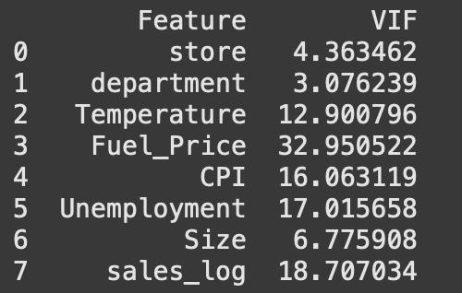
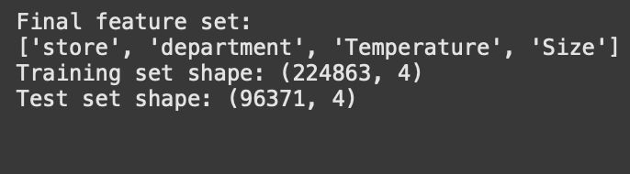
REMOVING MULITCOLLINEARITY USING VIF
Variance Inflation Factor (VIF) analysis was conducted to detect multicollinearity among numerical features. Features with VIF > 10 were removed to ensure a more reliable regression model.
By removing the high-VIF features, the final model will retain only the most independent predictors, leading to better generalization.
Train – Test split
To ensure a clean dataset, all negative sales values were removed. The target variable was transformed using a logarithmic scale (sales_log) to normalize the distribution. Standardization was applied to numerical features for better model performance.The dataset was then split into training and testing sets using a 70:30 ratio, ensuring sufficient data for model learning while retaining a robust test set for evaluation.

Slide 12
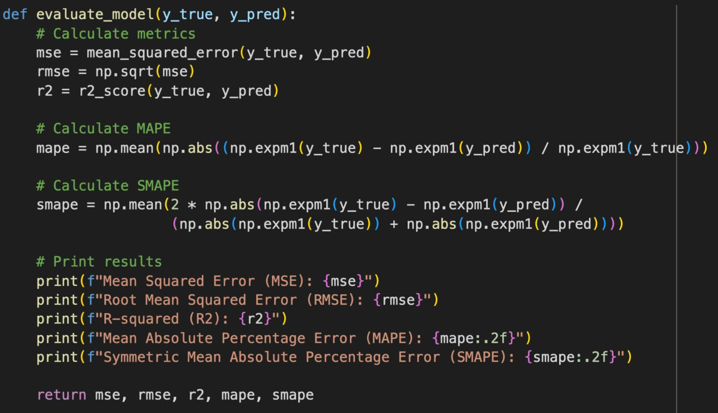
MODEL EVALUATION FUNCTION

Slide 13
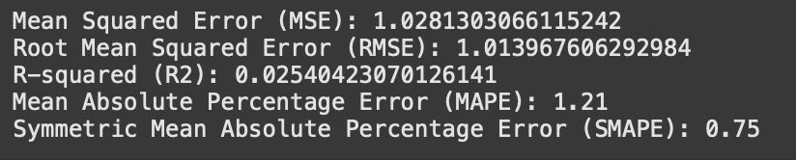
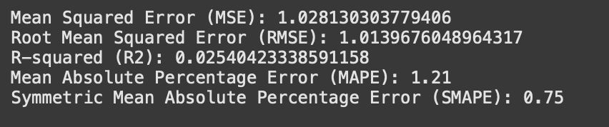
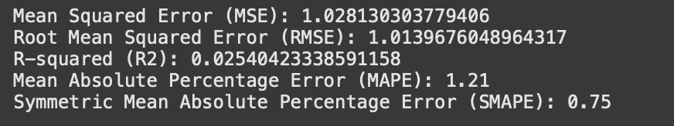
EVALUATION USING LINEAR MODELS
LINEAR REGRESSION
RIDGE MODEL
LASSO MODEL
Three linear models-Linear Regression, Ridge Regression, and Lasso Regression-were implemented to predict sales. However, the evaluation metrics (MSE, RMSE, R7, MAPE, and SMAPE) remained nearly identical across all models, indicating that linear models are not well-suited for this refined dataset.
The Residuals vs. Predicted Sales plot further supports this conclusion. The residuals appear randomly scattered without a clear pattern, but their spread suggests that the model fails to capture complex relationships within the data.
Given these findings, we proceed to explore more advanced machine learning models for improved performance.

Slide 14
PERFORMANCE EVALUATION OF ADVANCED MODEL
To overcome the limitations of linear models, we implemented Decision Tree Regressor, Random Forest Regressor, Gradient Boosting Regressor, and Extra Trees Regressor. These models were selected for their ability to capture complex patterns and improve predictive accuracy.
Each model was evaluated using Mean Squared Error (MSE), R-squared (R²), Mean Absolute Percentage Error (MAPE), and Symmetric Mean Absolute Percentage Error (SMAPE). The results showed a significant improvement in predictive performance compared to traditional linear models, demonstrating the effectiveness of tree-based methods in handling the refined dataset. Furthermore, a residual analysis was performed to validate model consistency.
The residuals for these advanced models exhibited a more random distribution compared to the linear regression models, indicating better generalization and reduced systematic bias. Among all, Random Forest Regressor outperformed the rest, striking an optimal balance between variance and bias, making it the most suitable choice for our dataset.
Key insights from the evaluation:
•Random Forest performed the best, achieving the highest accuracy and lowest error.
•Extra Trees Regressor showed stable performance, but slightly underperformed compared to Random Forest.
•Decision Tree showed competitive results, but had a higher tendency to overfit.
•Gradient Boosting underperformed, possibly due to hyperparameter sensitivity.
•Residual analysis confirmed Random Forest’s consistency, with a more random error distribution.
Conclusion:
Among all models, Random Forest was identified as the most optimal, striking the best balance between accuracy, stability, and generalization. This model will be used for further analysis and future sales predictions.Additionally, the insights gained from model evaluations and residual analysis will help refine feature selection and improve predictive performance in future iterations.

Slide 15
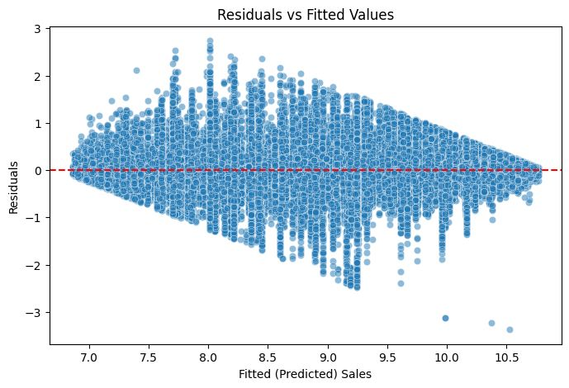
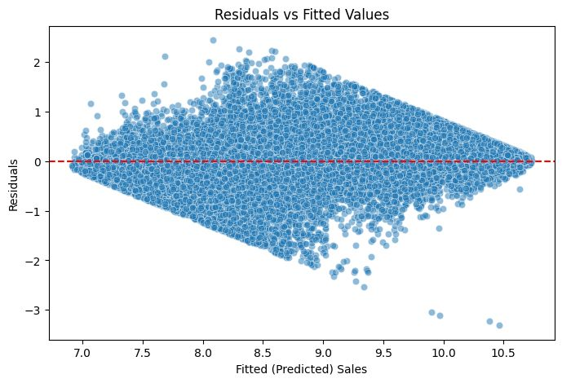
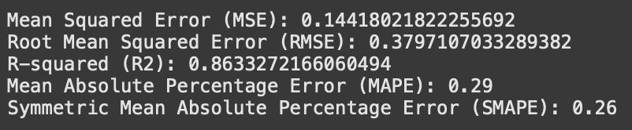
DECISION TREE MODEL
RANDOM FOREST

Slide 16
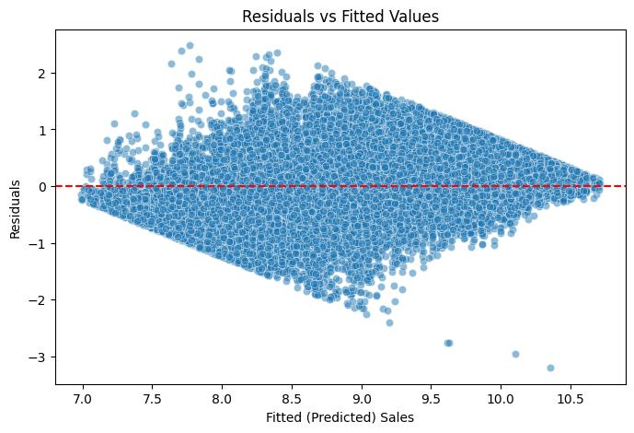
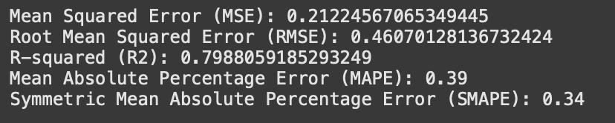
ExtraTreesRegressor

Slide 17
FUTURE WORK
1.Hyperparameter Tuning & Optimization – Further fine-tuning of the Random Forest model using GridSearchCV or Bayesian Optimization to enhance predictive accuracy.
2.Ensemble Learning Approaches – Exploring stacking and boosting techniques by combining models like XGBoost, Random Forest, and Linear Regression to improve performance.
3.Advanced Feature Engineering – Identifying new relevant features, handling seasonality, and incorporating external factors like holidays and promotions.
4.Time Series Forecasting – Utilizing ARIMA and Prophet models to forecast long-term sales trends, seasonality effects, and demand fluctuations.
5.Real-world Deployment & Business Impact – Integrating the model into a live system with automated updates and dashboard visualization for business insights and decision-making.

Slide 18
CONCLUSION
This project began with a comprehensive Exploratory Data Analysis (EDA), where we processed raw sales data, handled missing values, removed multicollinearity, and performed various visualizations to gain initial insights. We then built and evaluated multiple machine learning models, starting with linear regression-based approaches, which proved insufficient for this dataset. Advanced models like Decision Trees, Random Forest, and Gradient Boosting were implemented, with Random Forest emerging as the most effective model.With further improvements, this predictive framework can be instrumental in forecasting future sales trends, optimizing inventory management, and aiding strategic business decisions. Moving forward, integrating time series forecasting and deploying the model in a real-world environment will enhance its impact, providing valuable insights for business growth and development.

